Slide 1

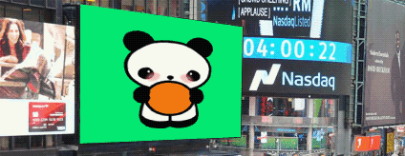
Quantitative Finance Final Project – QQQ Momentum Strategy
ECO 43000
Professor: John Droescher
Student: Riya Dcosta, Serenity Sheppard, Reina Osorio
https://www.etf.com/QQQ

Slide 2
Introduction
• ETF Used: QQQ (Nasdaq-100
• Strategy: Momentum-based long/short portfolio
• Factors: 1M, 3M, 6M, 12M returns
• Tools: Python, Pandas, yfinance

Slide 3
Data & Methodology
Data Source: Yahoo Finance (via yfinance)
Universe: All QQQ components (102 stocks)
Period: 5 Years of historical data
Calculations: Momentum factors → Z-scores → Long/Short basket

Slide 4
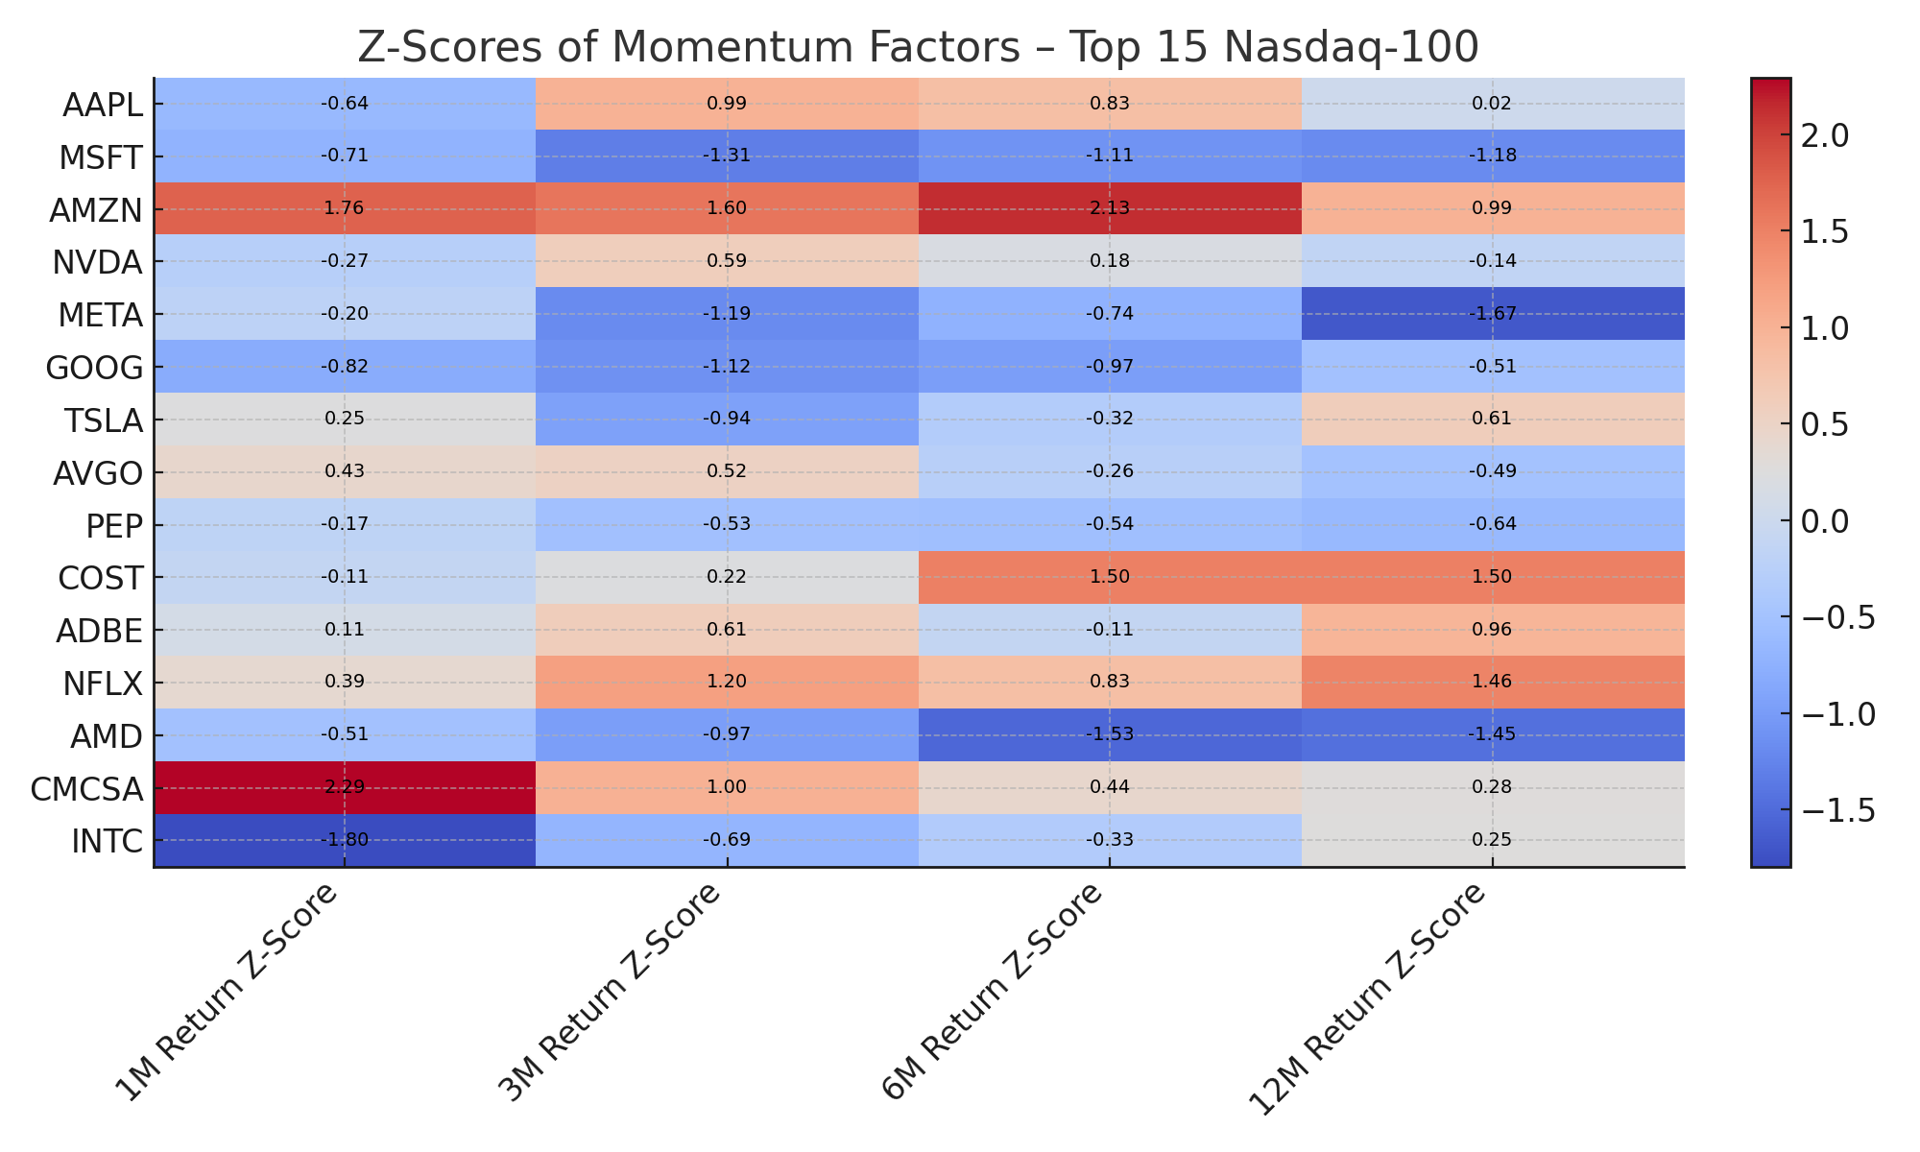
Momentum Factors – Barry Cox

Slide 5
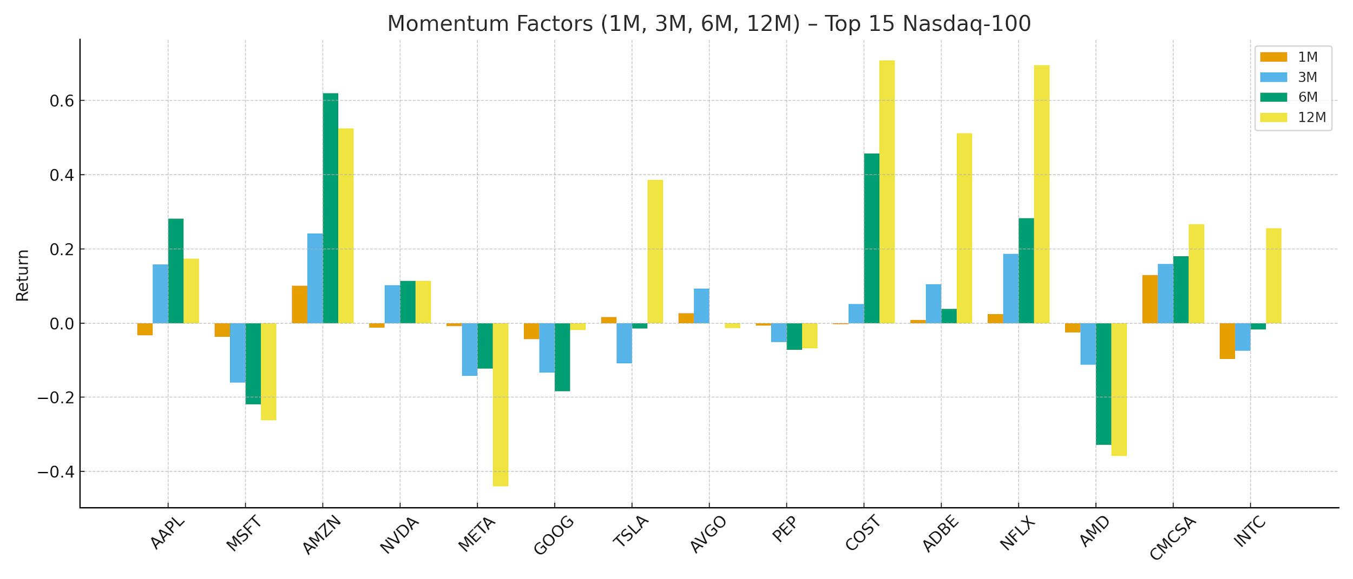
Table 1 – Asset Momentum Factors

Slide 6
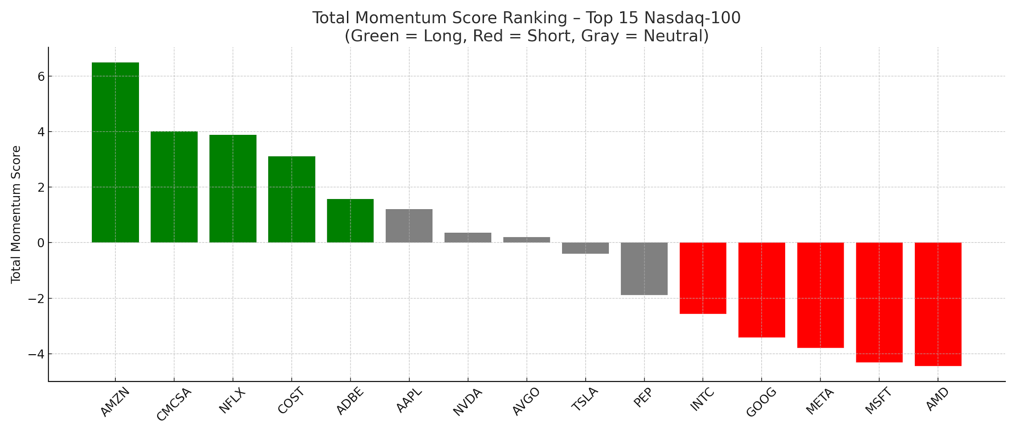
Z-Scores & Total Momentum Score

Slide 7
Long & Short Portfolio Construction
Date | Long Basket | Short Basket
Oct 31, 2025 | MU, AMD, WBD, PLTR, INTC, APP, LRCX, SHOP, AVGO, GOOGL, GOOG, KLAC, ASML, TSLA, AMAT | LIN, TMUS, ADP, SNPS, PAYX, CTAS, ROP, CMCSA, LULU, TTD, VRSK, CSGP, DXCM, MSTR, CHTR

Slide 8
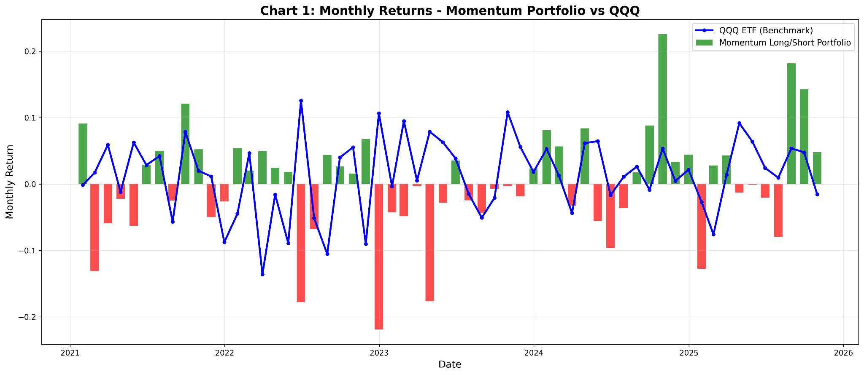
Backtest – Monthly Returns
Green bars = months our strategy made money
Red bars = months our strategy lost money
Blue line = QQQ benchmark performance
Notes:
- Our strategy had big wins in late 2025 (over 20% some months!) - But also had painful losses in 2023 (some months down 20%) - Overall: mixed results - some great months, some rough months

Slide 9
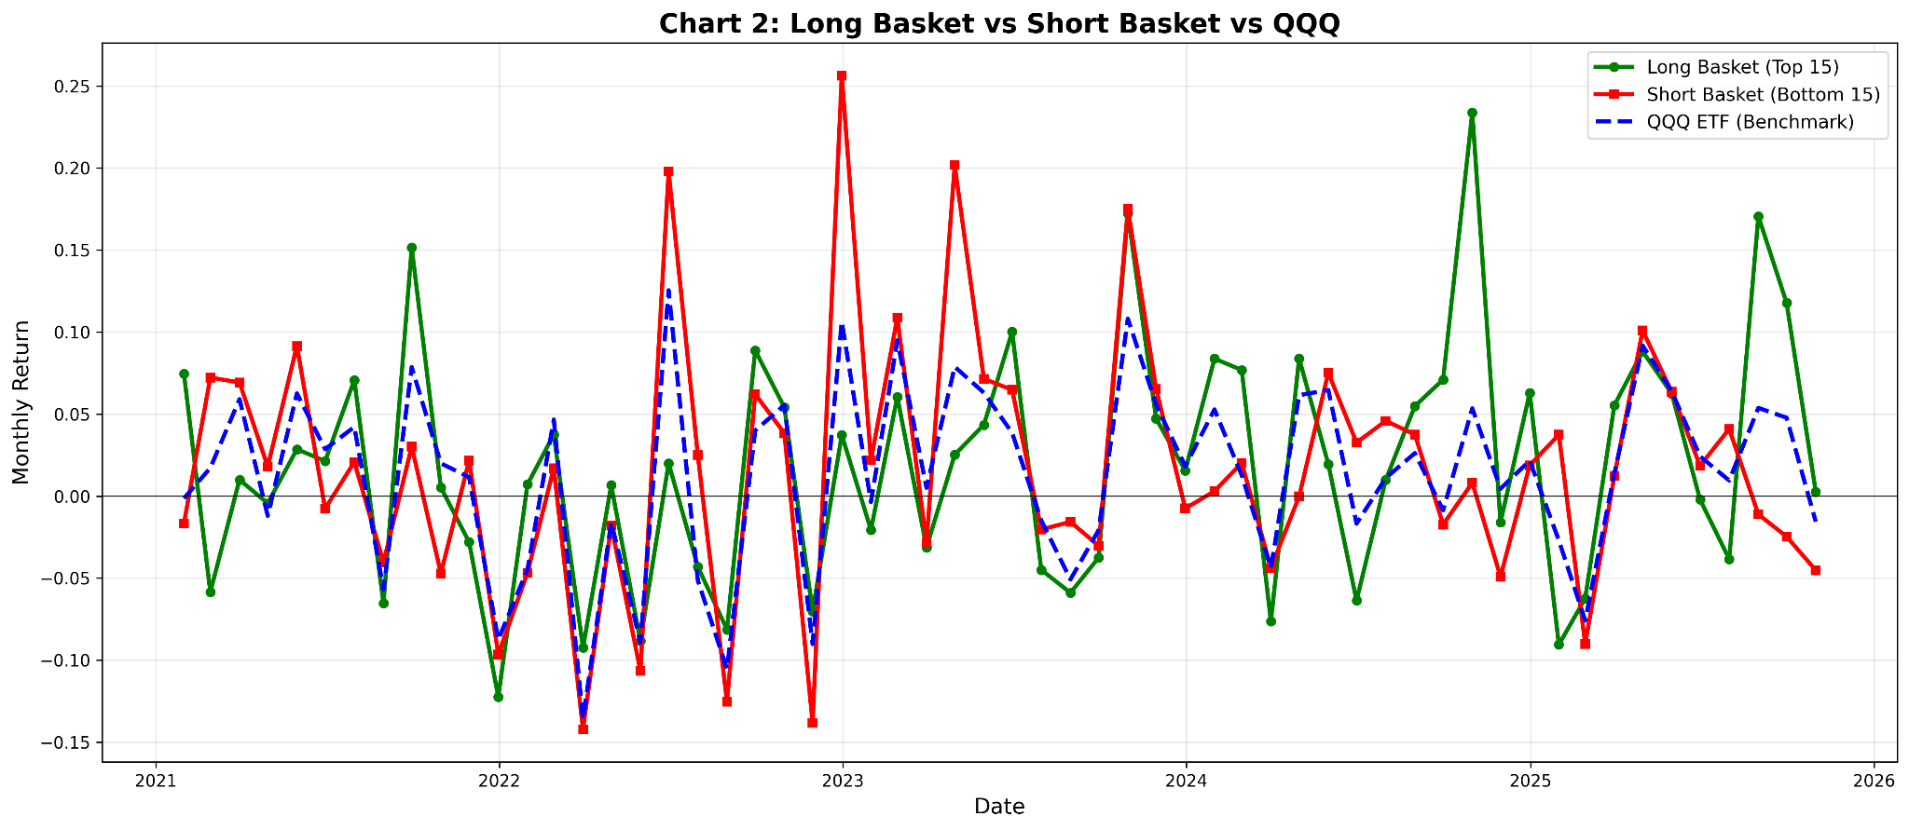
Backtest – Long vs Short vs QQQ
Green line = our long basket (stocks we bought)
Red line = our short basket (stocks we bet against)
Blue dashed line = QQQ benchmark
Long basket was pretty volatile - big swings up and down
Short basket also moved a lot - sometimes gained when it should have lost
Notes:
- This shows both parts of our strategy were unpredictable

Slide 10
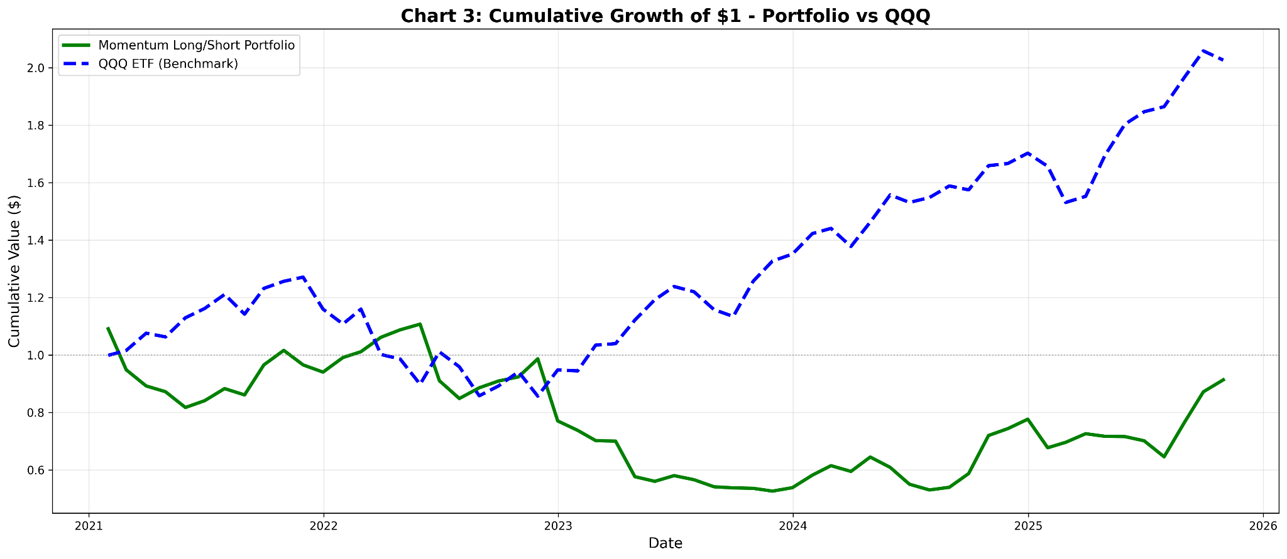
Backtest – Cumulative Returns
If $1 would be invested on this strategy, here's what happened
Green line (our portfolio): dropped to around $0.50, ended at $0.90
Blue dashed line (QQQ): grew from $1 to over $2
Our strategy LOST about 9% over 5 years
QQQ GAINED over 100% in the same period
Notes:
Our long/short approach struggled during this rising market

Slide 11
Performance Summary (Table 2)
Metric | Portfolio | QQQ Benchmark
Total Return | -8.65% | 102.60%
Annualized Return | 2.07% | 17.93%
Annualized Volatility | 27.99% | 19.64%
Sharpe Ratio | 0.07 | 0.91
Max Drawdown | -52.47% | -32.58%
Our strategy lost 8.65% over 5 years
QQQ gained 102.60% - doubled money!
Our volatility was 28% (vs QQQ's 20%) shows it was riskier
Sharpe ratio of 0.07 is not good (QQQ's was 0.91)
Max drawdown of -52% means we lost half our value at the worst point
-
Notes:
higher risk, worse returns - the worst combination

Slide 12
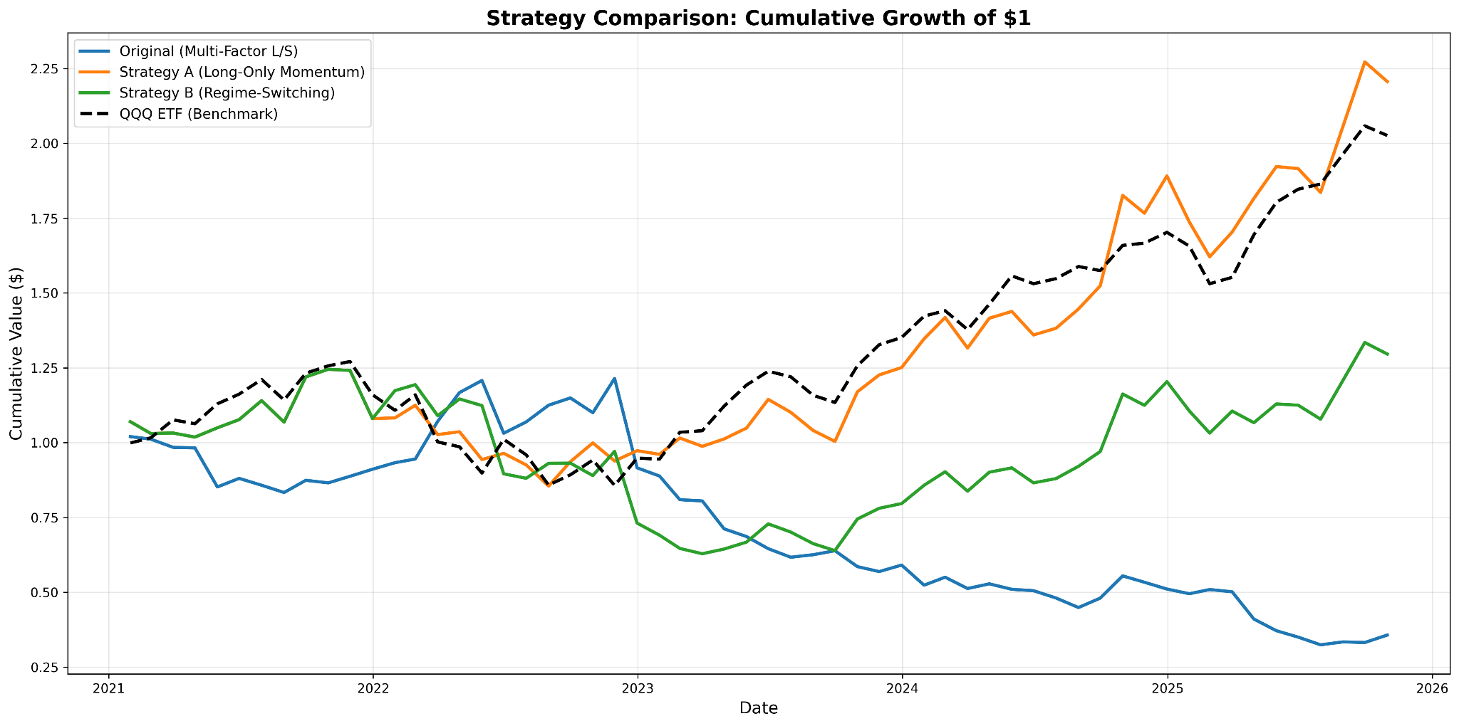
Testing Different Approaches
Original Line: Long/short with multiple factors - crashed to $0.35
Strategy A Line: Long-only momentum - grew to $2.25 (winner!)
Strategy B Line: Regime-switching - grew to $1.30 (decent)
Black dashed (QQQ benchmark): grew to $2.05
Notes:
we tested 3 different approaches
Key insight: Long-only momentum actually BEAT the market.

Slide 13
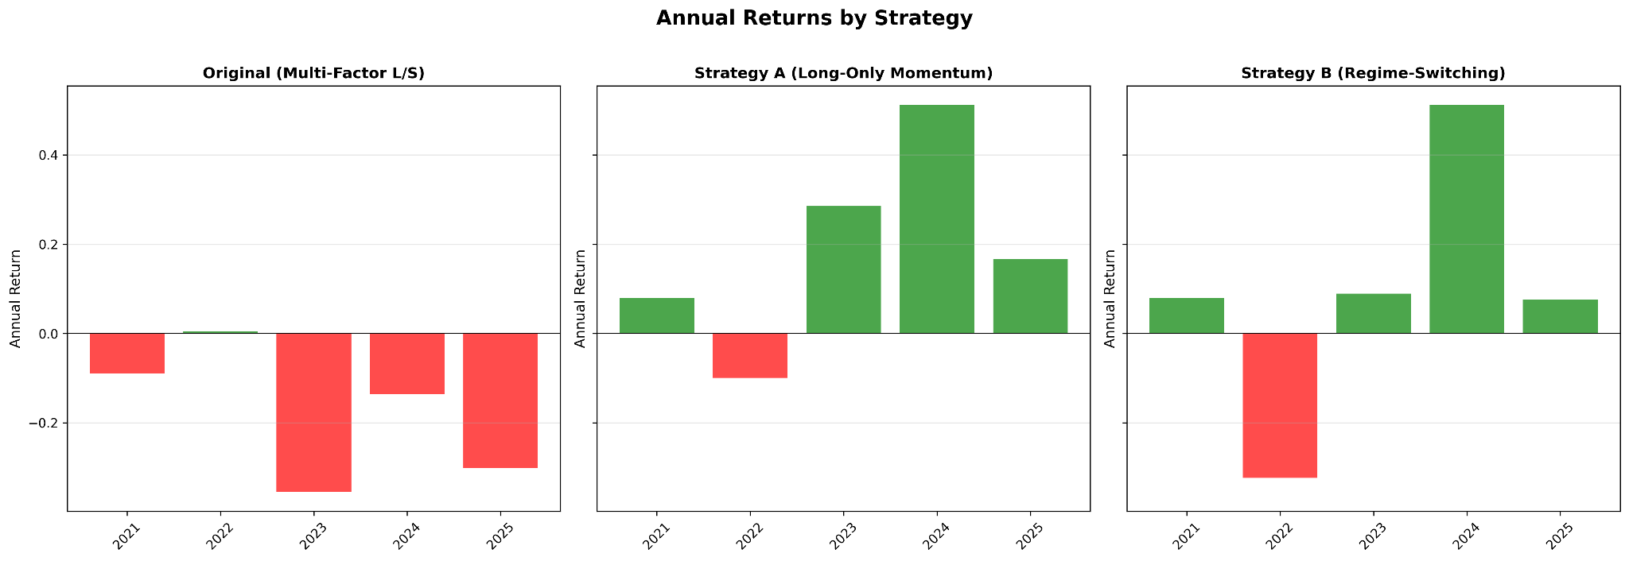
Annual Returns Comparison
Original strategy (left): Lost money in 4 out of 5 years
Strategy A (middle): Made money in 4 out of 5 years
Strategy B (right): Made money in 4 out of 5 years
2024 was huge: Strategy A gained 55%, original lost money
The problem? Shorting hurt us during the 2023-2025 bull run
Solution: Remove shorts = capture more upside

Slide 14
Comparative Performance Analysis
Strategy | Total Return | Annualized Return | Annualized Volatility | Sharpe Ratio | Max Drawdown
Original (Multi-Factor L/S) | -0.643147478 | -0.164907358 | 0.25074322 | -0.65767424 | -0.732963947
Strategy A (Long-Only Momentum) | 1.206221408 | 0.208176226 | 0.231613789 | 0.898807566 | -0.313356675
Strategy B (Regime-Switching) | 0.295782931 | 0.096055259 | 0.275160396 | 0.349088241 | -0.495072325
QQQ ETF (Benchmark) | 1.026002698 | 0.179301705 | 0.196366504 | 0.913097197 | -0.325770182
Original strategy CRASHED: Lost 64% total, dropped 73% at worst point - disaster
Strategy A: Made 121%, only dropped 31% max - beat the market.
Strategy B was middle-ground: Made 30%, but dropped 50% at one point - risky
Risk-adjusted scores: Strategy A (0.90) nearly matched QQQ (0.91), original was NEGATIVE
Strategy A had best returns AND lowest risk - dominated everything
Notes:
This shows the exact numbers for all three strategies compared to QQQ
Our original lost 64% and crashed 73% at its worst. Strategy A made 121%, beat QQQ, and only dropped 31% max. Its risk score of 0.90 is basically as good as QQQ's 0.91. Strategy B made 30% but was super volatile. Bottom line: Strategy A won on every measure with better returns, lower risk, smaller crashes.

Slide 15
Interpretation
Did long/short beat QQQ? No - we lost 9% while QQQ gained 103%.
Was long basket strong? Mixed - volatile and unpredictable
Did shorts drag us down? Yes. It outperformance in the rising markets.
Market regime impact: 2021-2025 was mostly went up which was bad for strategies that bet against stocks,
Key lesson: Momentum works, but shorting doesn't work in rising markets.
Strategy A (long-only) proved momentum is real but just needed better execution.

Slide 16
Conclusion
QQQ gave us exactly what we needed: Enough stocks (100+) to properly test momentum strategies.
The z-scores and rankings correctly spotted winning vs losing stocks
Long/short approach didn't isolate profits like we hoped: Betting against stocks killed returns when markets rose.
But momentum itself is VERY real: Our second try (only buying winners) made 125% and beat the market.
What we learned: Right analysis + wrong timing/execution = poor results. Adapt your approach to current conditions.

Slide 17
Python Code Used
Link to GitHub python scripts and charts

